Slide 1
“So, you want to build an image classifier…”
CSCI 8360
Lecture 6

Slide 2
What is the goal of classification?
Learn a function f
Maps: continuous space (data) to discrete space (label)
f(X) → Y

Slide 3
What is needed for classification?
Objective function
Labeled training data
Features
Decision tree, Logistic Regression, Naïve Bayes, etc
???

Slide 4
Feature engineering
Documents
Time series
Recommendation
Bag-of-words
Term frequencies
TF-IDF
word2vec
Fourier coefficients
Cepstrum
KL-divergence
SVD
Alternating Least Squares
Dimensionality reduction
What about images?

Slide 5
Level 0: Pixels
Flatten image into a feature vector
Raster scan
Only works at all if ALL images have the same dimensions
Rarely works regardless

Slide 6
Level 1: Pixel features
Normalization
Equalization
Filters

Slide 7
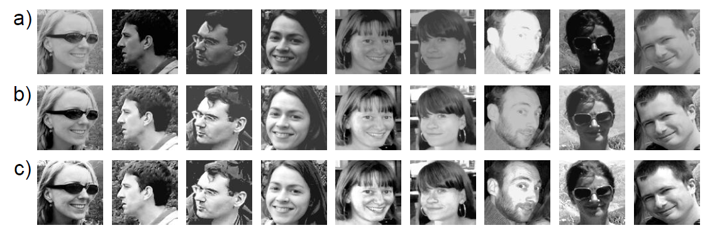
Normalization
Normalize 1st and 2nd moments
Removes contrast and additive luminescence variations
Before
After

Slide 8
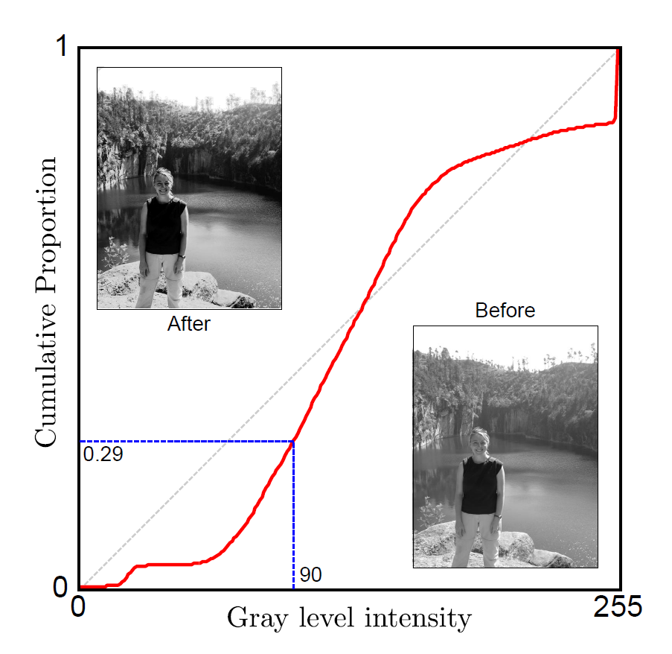
Histogram Equalization
Consider luminescence as a cumulative distribution function (CDF)
Normalize the CDF to be linear
Enhances global contrast (potentially by magnifying noise)

Slide 9
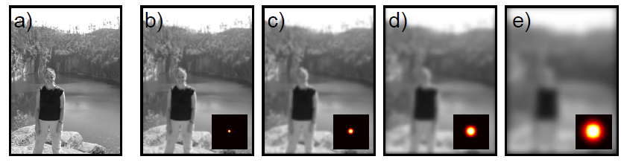
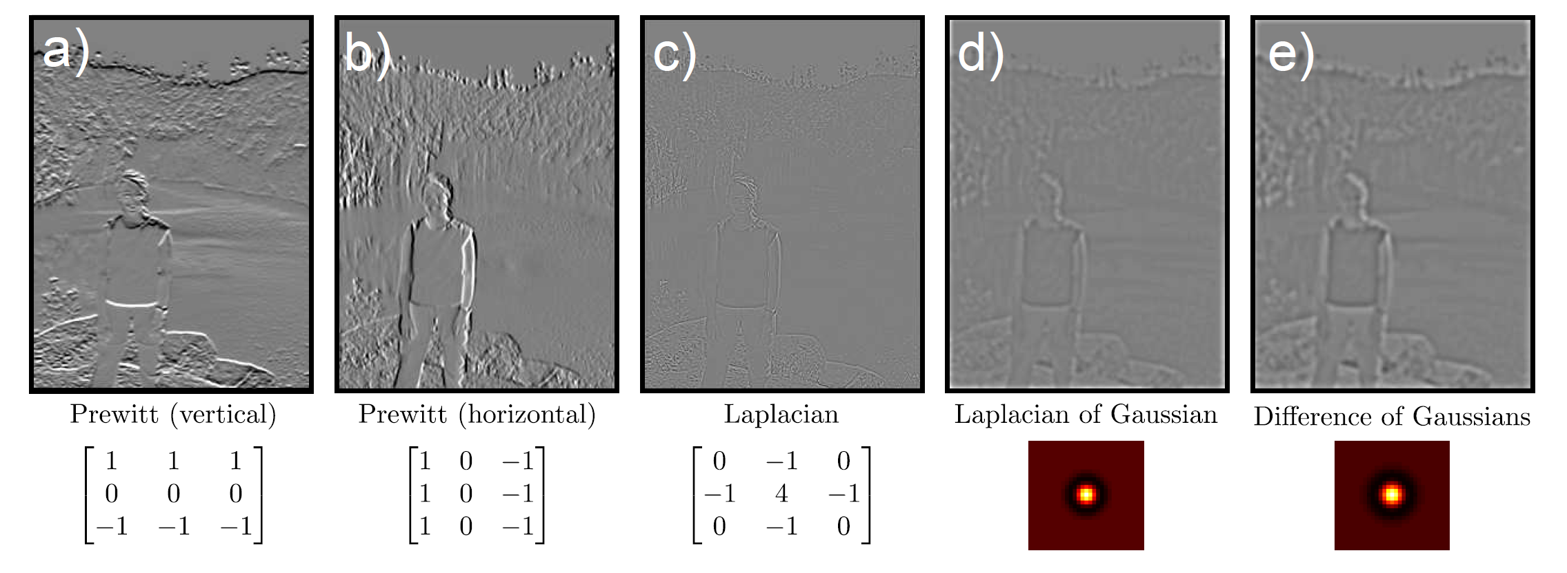
Filters
Blurring
Image gradients

Slide 10
Level 2: Pixel functions
Edges and corners
SIFT & SURF
Textures

Slide 11
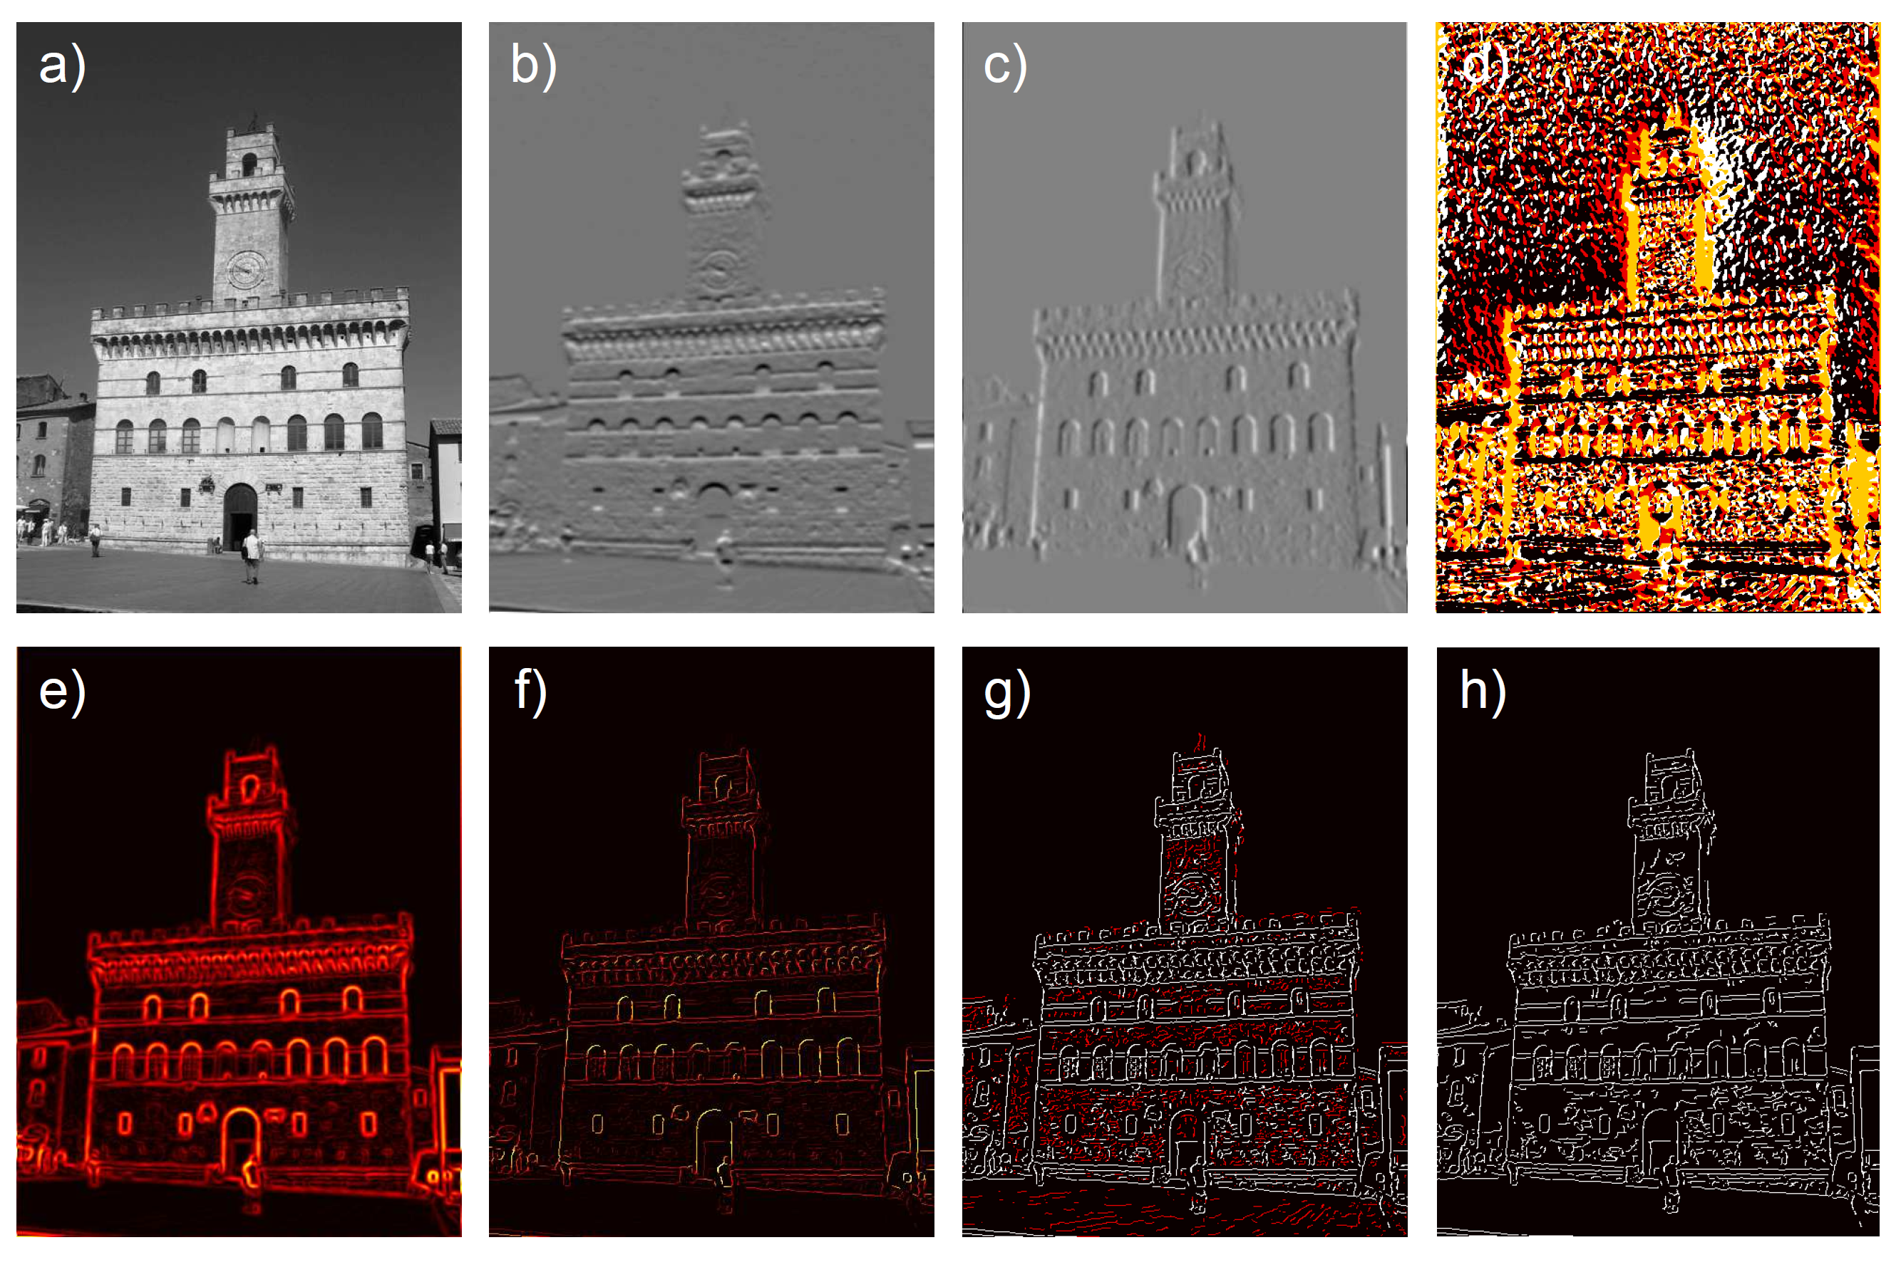
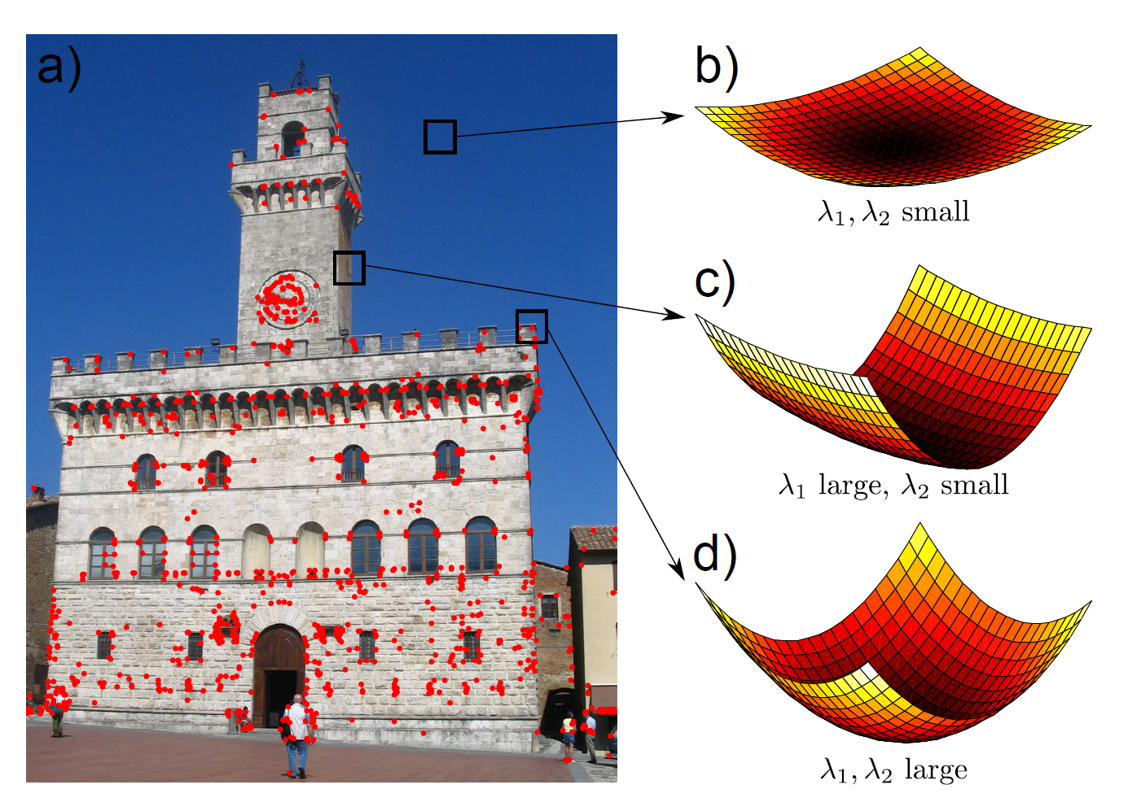
Edges and Corners
Canny Edge Detector
Combination of horizontal and vertical image gradients
Harris Corner Detector

Slide 12
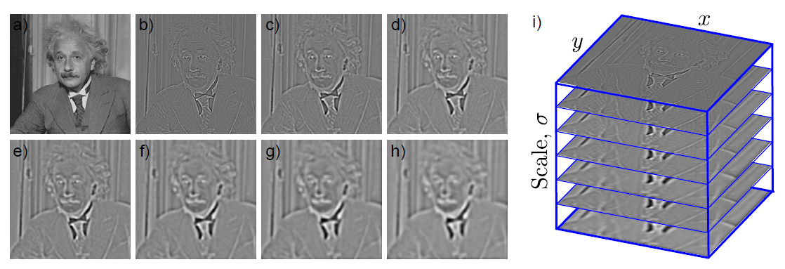
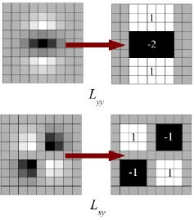
SIFT and SURF
SIFT (Scale-Invariant Feature Transform)
SURF (Speeded-Up Robust Features)
Notes:
In SIFT, Lowe approximated Laplacian of Gaussian with Difference of Gaussian for finding scale-space. SURF goes a little further and approximates LoG with Box Filter. Below image shows a demonstration of such an approximation. One big advantage of this approximation is that, convolution with box filter can be easily calculated with the help of integral images. And it can be done in parallel for different scales. Also the SURF rely on determinant of Hessian matrix for both scale and location.
To detect interest points, SURF uses an integer approximation of the determinant of Hessian blob detector, which can be computed with 3 integer operations using a precomputed integral image. Its feature descriptor is based on the sum of the Haar wavelet response around the point of interest. These can also be computed with the aid of the integral image.

Slide 13
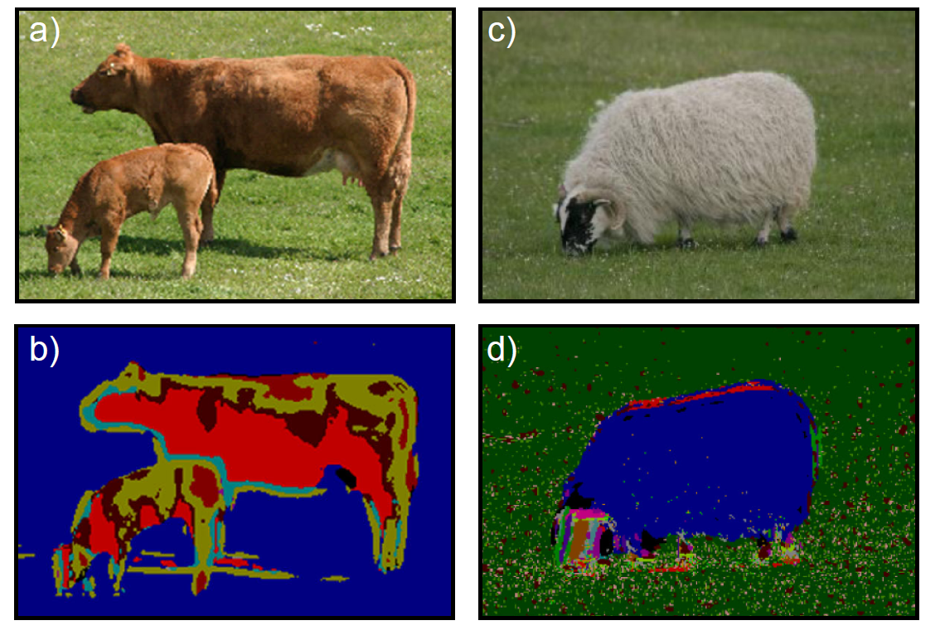
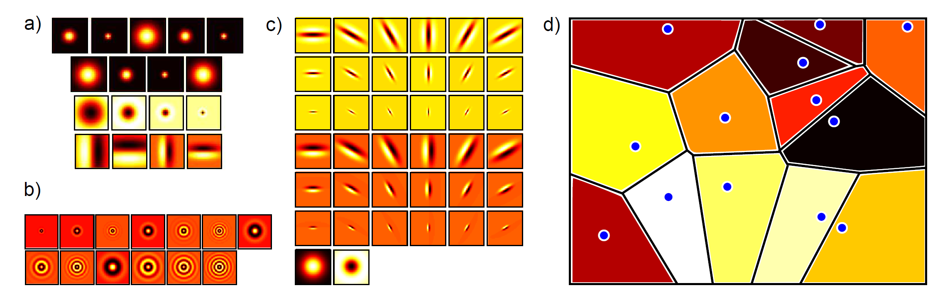
Textures
Textons
Replace each pixel with integer representing “pixel type”
Take a bank of filters (gaussian, laplacian, etc) and apply to images
Cluster pixels in filter space
For new pixel, filter surrounding region with filter bank, and assign to nearest cluster

Slide 14
Level 3: Hierarchical pixel functions
Convolutional neural networks (CNNs) and Deep Learning
http://deeplearning4j.org/convolutionalnets

Slide 15
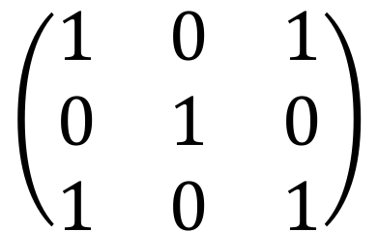
What is a “convolution”?
Two matrices:
Image (of course)
Filter (small matrix)
Run filter over image, taking dot products
$$\left(\begin{matrix}1 & 0 & 1 \\ 0 & 1 & 0 \\ 1 & 0 & 1\end{matrix}\right)$$

Slide 16
What is a “convolution”?
Notes:
The green curve shows the convolution of the blue and red curves as a function of t, the position indicated by the vertical green line. The gray region indicates the product g(tau)f(t-tau) as a function of t, so its area as a function of t is precisely the convolution

Slide 17
What is a “neural network”?

Slide 18
Stacked feed-forward networks

Slide 19
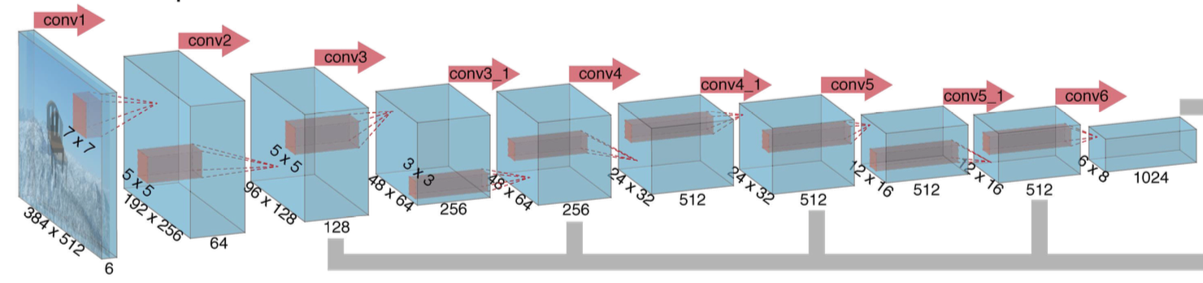
Stacked feed-forward networks

Slide 20
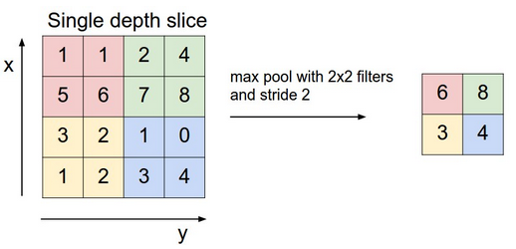
Terminology
Feature maps
The output of one layer of a CNN
Stride
Size (in pixels) of the move a filter makes over neighborhoods of pixels
Pooling
“Summary” of the output of a filter
Popular choices: mean, max
Activation functions
Function determining whether or not an individual neuron fires
Popular choices: ReLU, tanh, sigmoid

Slide 21
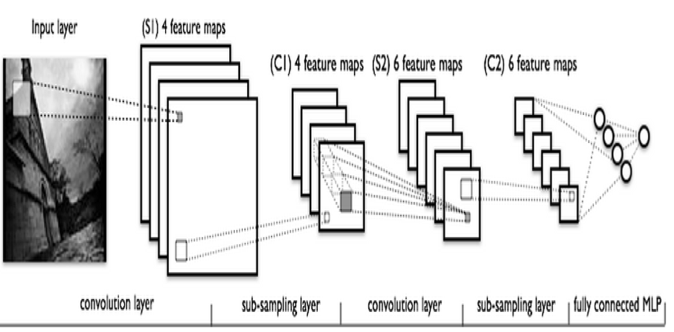
CNN Pipeline
Notes:
- The actual input image that is scanned for features. The light rectangle is the filter that passes over it.
- Activation maps stacked atop one another, one for each filter you employ. The larger rectangle is one patch to be downsampled.
- The activation maps condensed through downsampling.
- A new set of activation maps created by passing filters over the first downsampled stack.
- The second downsampling, which condenses the second set of activation maps.
- A fully connected layer that classifies output with one label per node.

Slide 22
References
Prince, Simon JD. Computer vision: models, learning, and inference. Cambridge University Press, 2012. Chapter 13: Image Processing and Feature Extraction.
Coelho, Luis Pedro, and Willi Richert. Building machine learning systems with Python. Packt Publishing Ltd, 2015. Chapter 10: Computer Vision – Pattern Recognition
DL4J Documentation: http://deeplearning4j.org/convolutionalnets
Andrej Karpathy’s CNN tutorial: https://cs231n.github.io/convolutional-networks/

